Slide 1
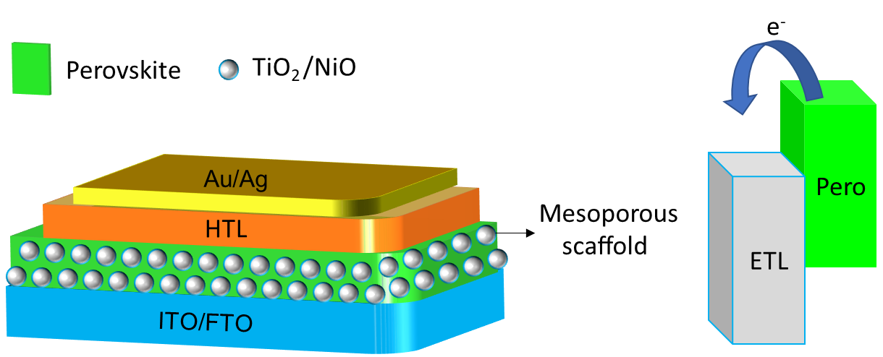
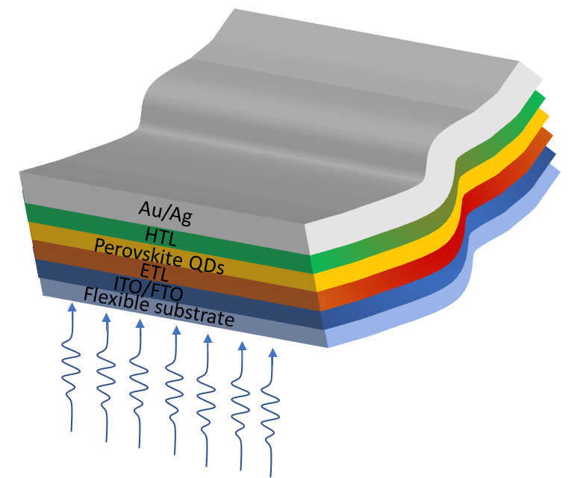
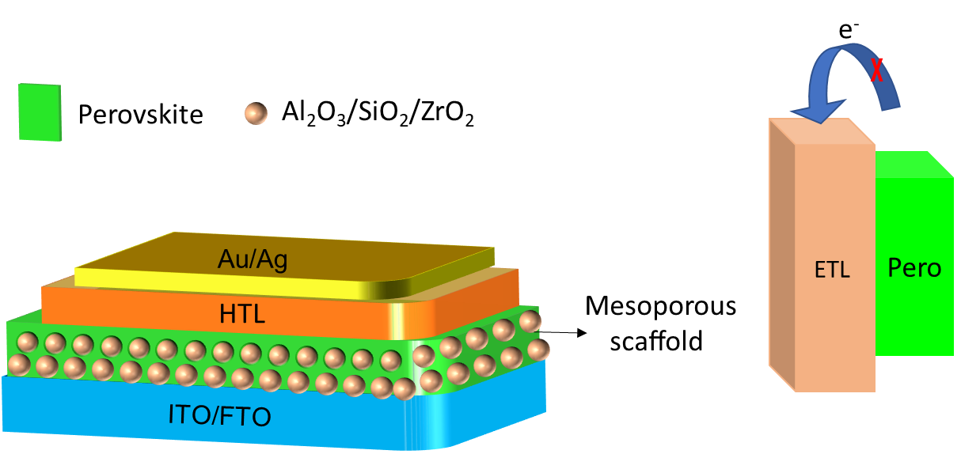
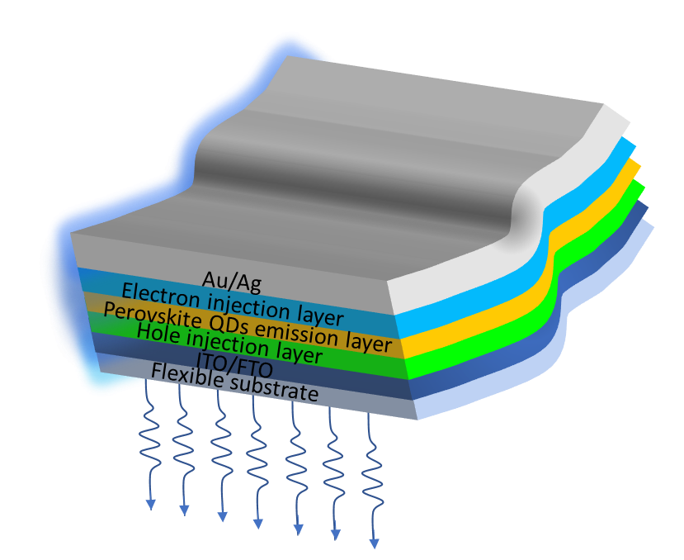
a)
c)
Perovskite sensitized in an active scaﬀold
Flexible solar cell using perovskite QDs
b)
d)
Perovskite sensitized in an passive scaﬀold
Flexible LED using perovskite QDs

Slide 2
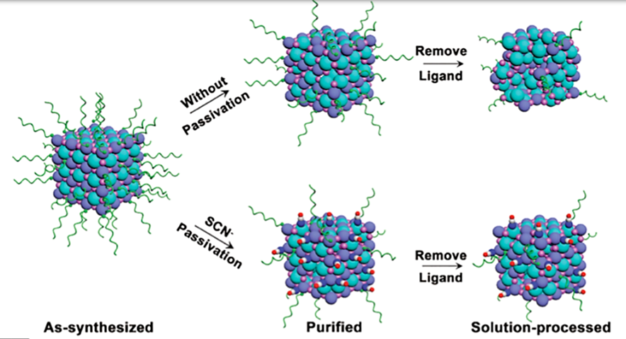





Slide 3
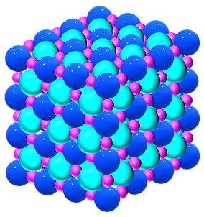

Slide 4
i)
Remove
Ligands
a)
ii)
Remove
Ligands
SCN⁻

Slide 5
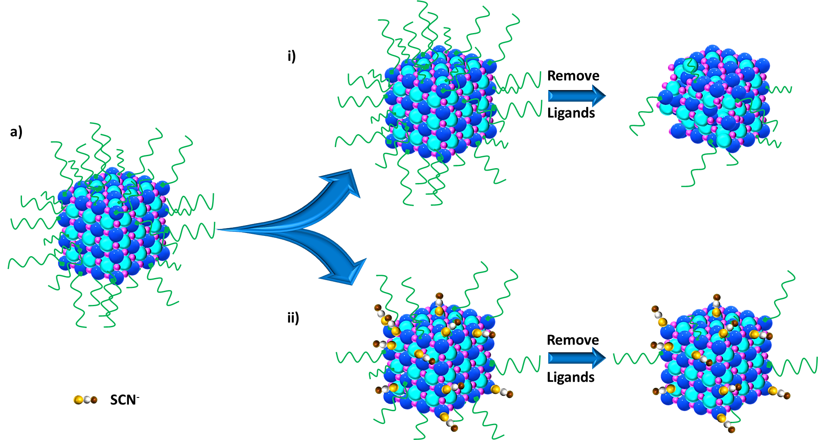

Slide 6
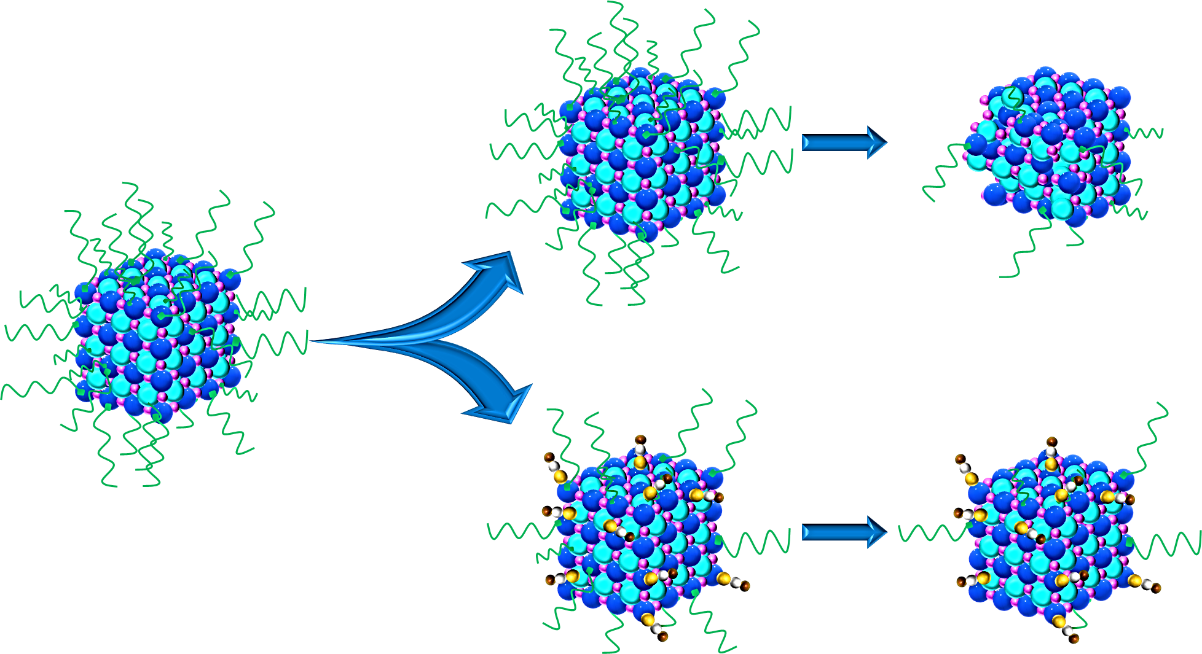

Slide 7
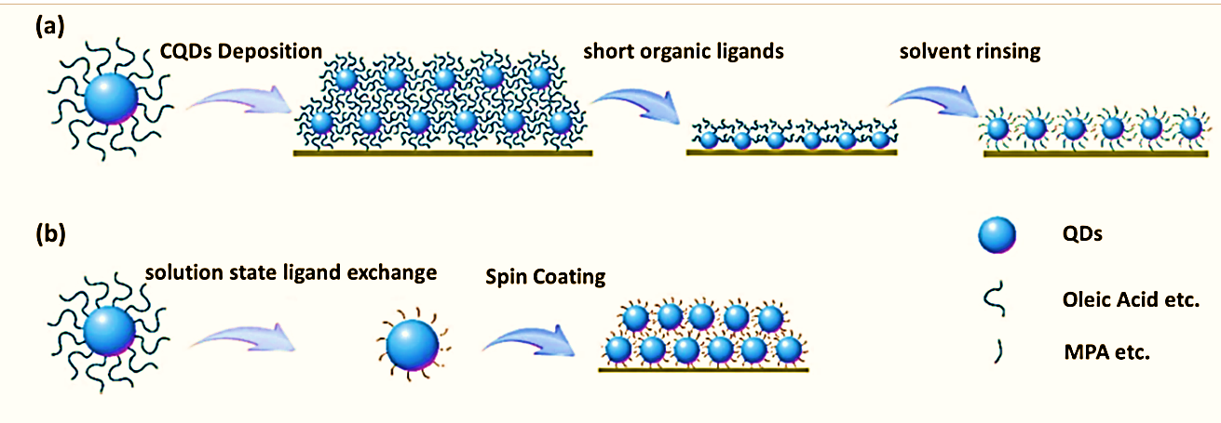

Slide 8
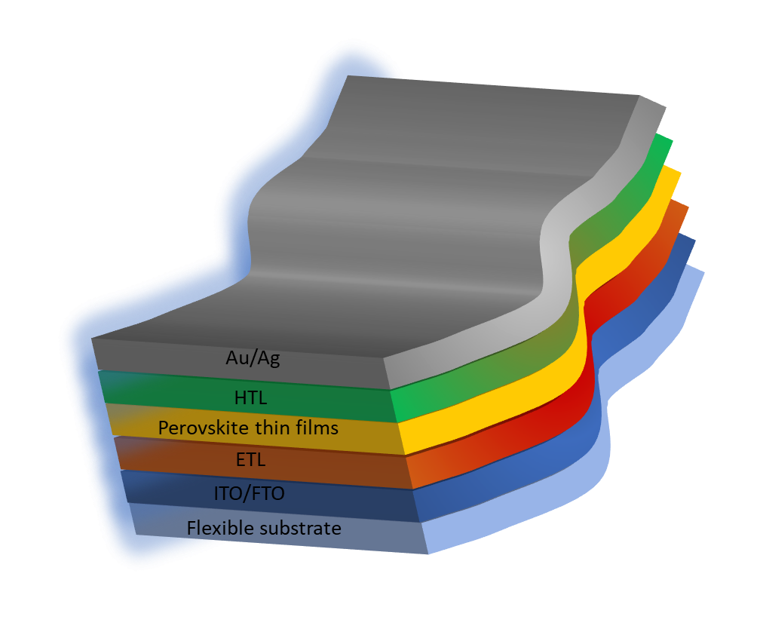


Slide 9
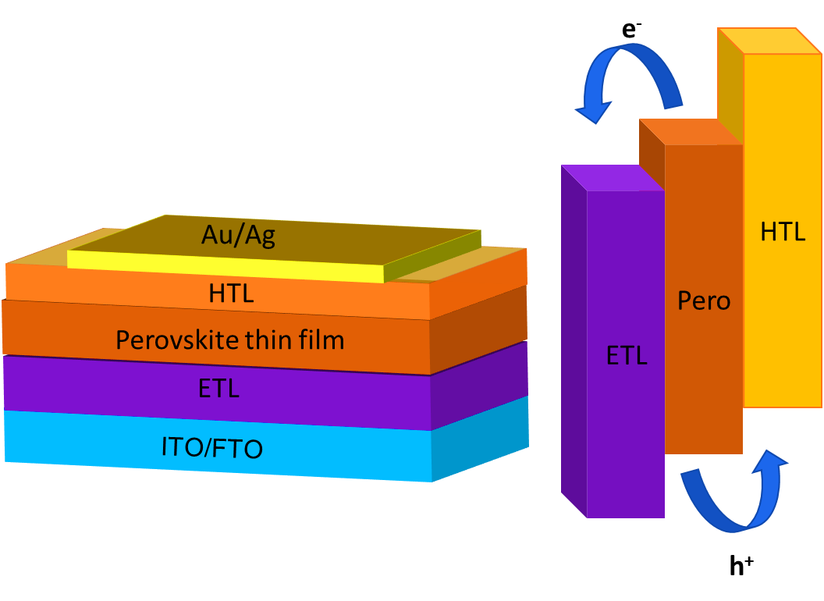
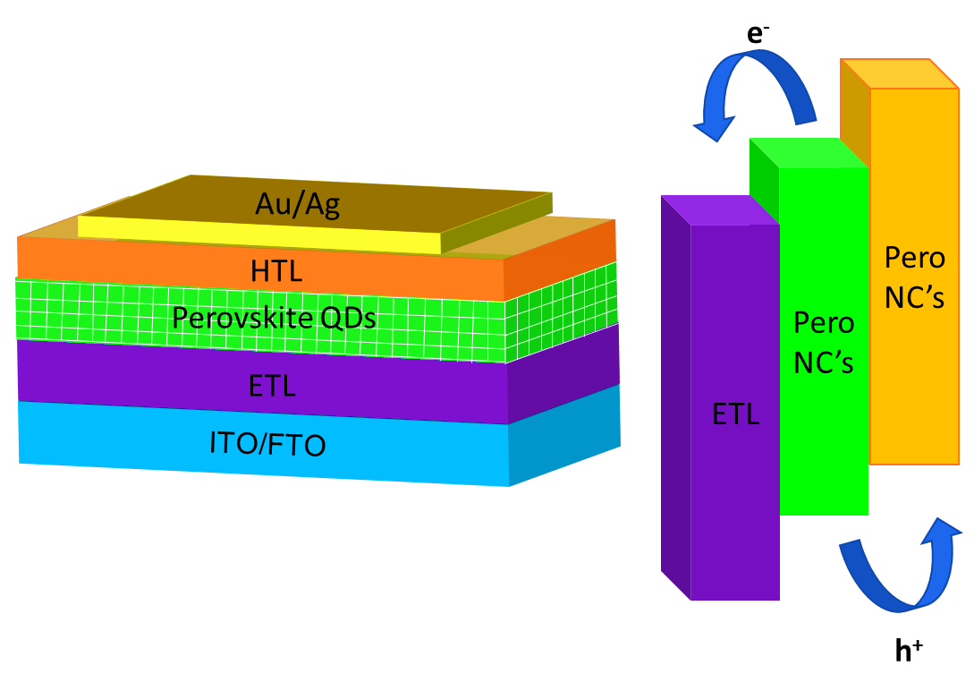
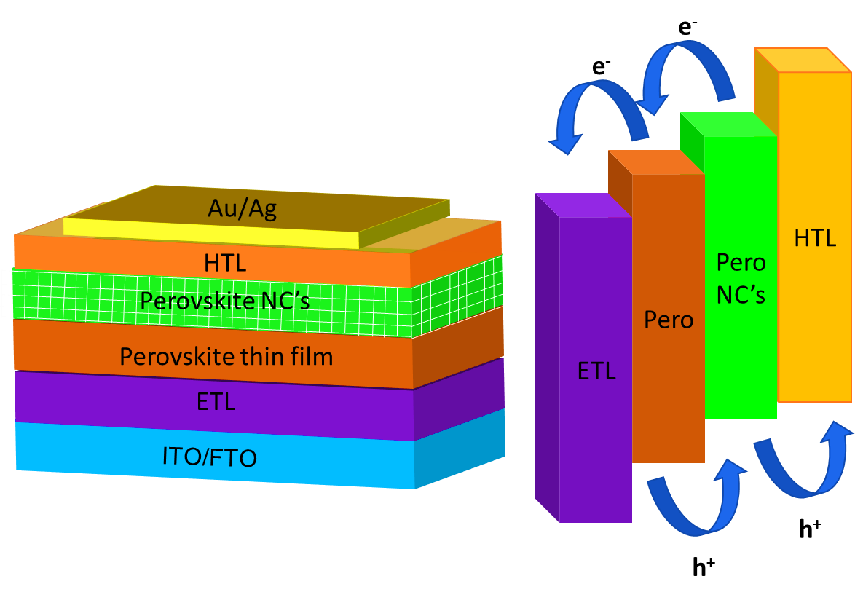
solar device with perovskite thin layer as active layer.
solar device with perovskite NC’s as active layer.
Hybrid perovskite heterojunction solar cell

Slide 10
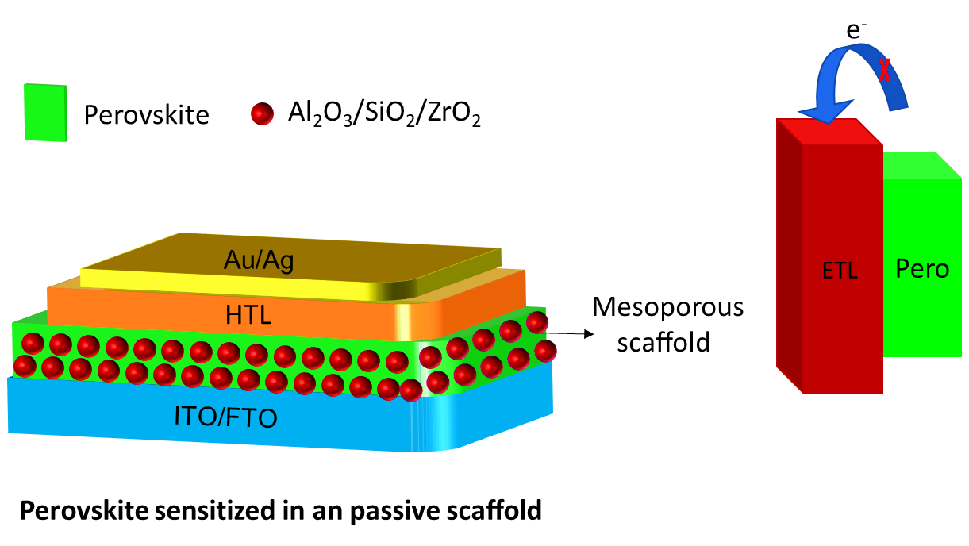
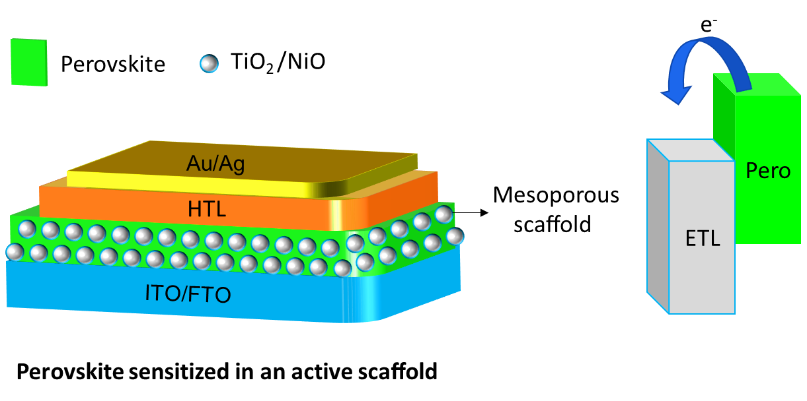
Mesoporous scaffold for templet based NC’s

Slide 11
Better matching energy levels between perovskites and HTL by Mixed pero NC’s
e⁻
e⁻
HTL
e⁻
Pero B NC’s
d)
Perovskite A NC’s
Perovskite B NC’s
Pero
A NC’s
Pero
Au/Ag
ETL
HTL
Au/Ag
Perovskite NC’s
Perovskite thin film
ETL
ITO/FTO
h⁺
h⁺
h⁺

Slide 12
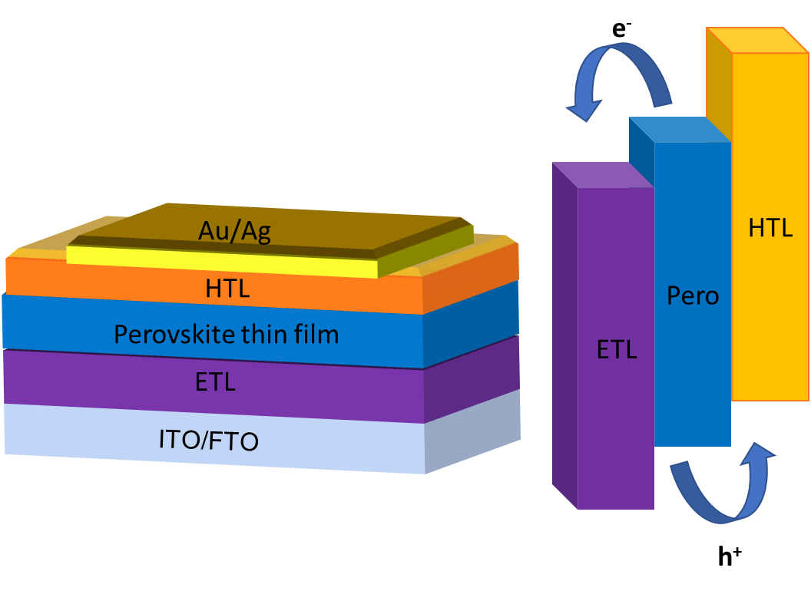
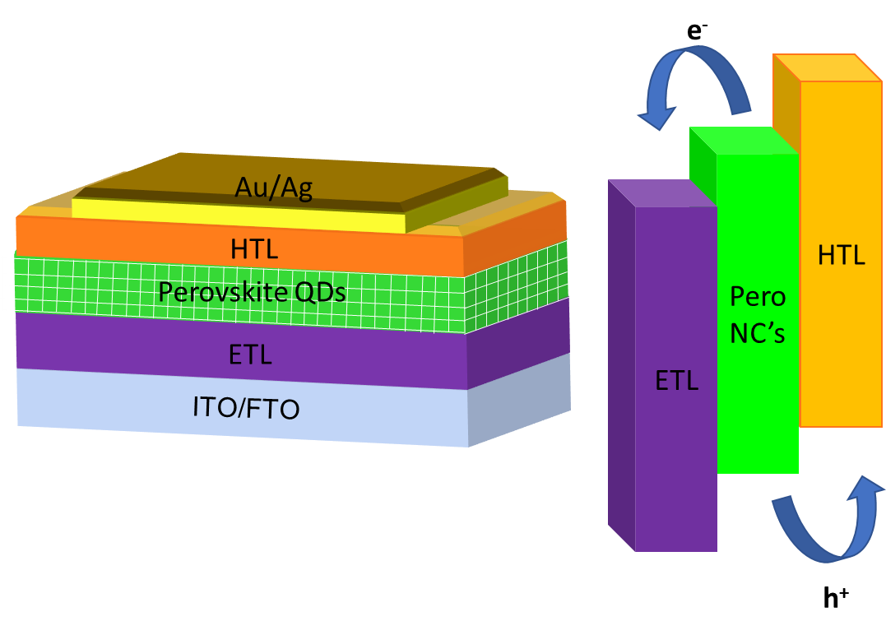
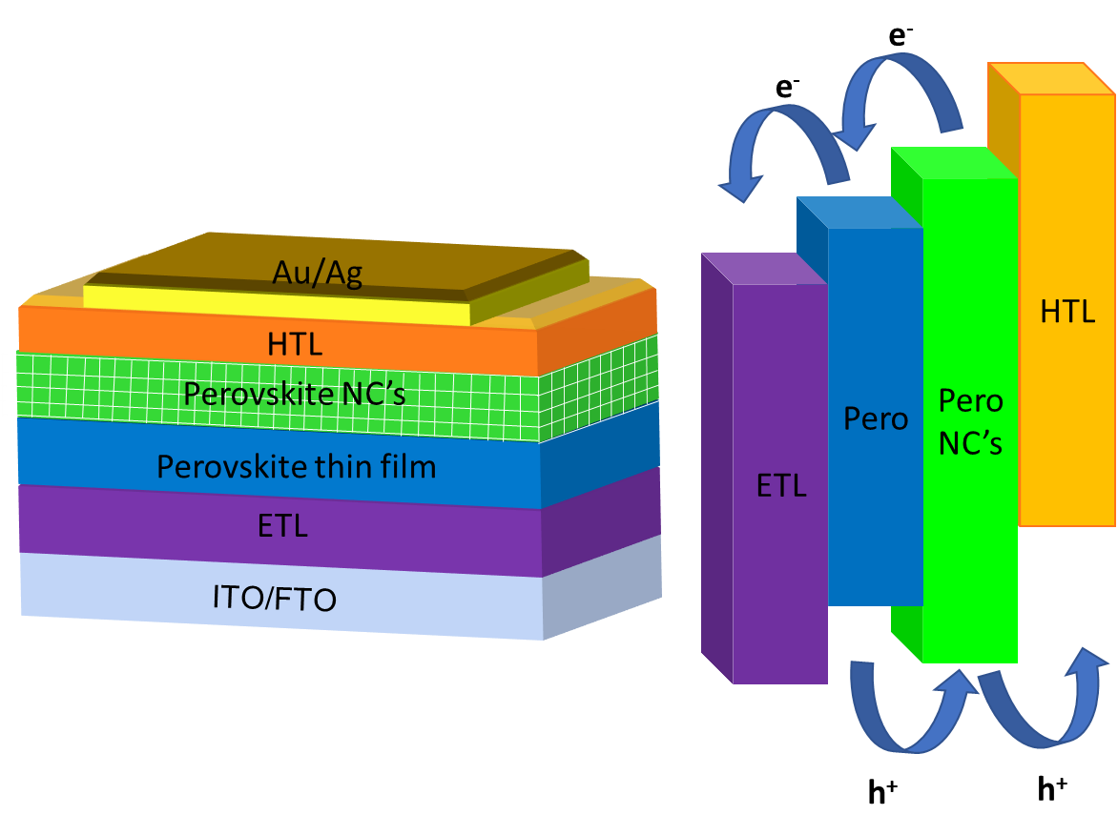
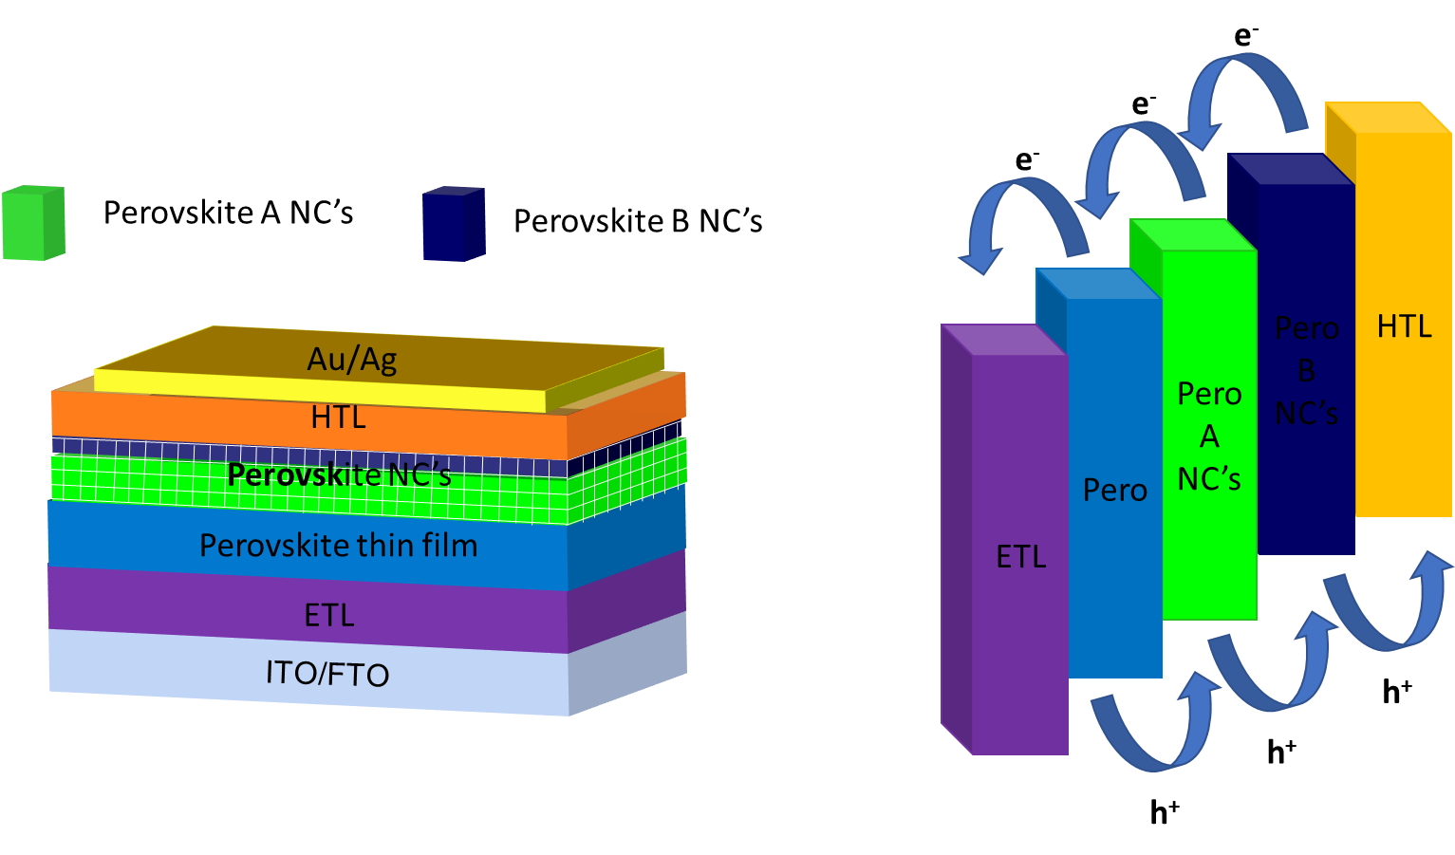
a)
b)
c)
d)

Slide 13
Seeking cheap inorganic hole transport materials instead of expensive organic HTL
e⁻
e)
e⁻
HTL
Pero NC’s
Pero
Au/Ag
ETL
HTL
Perovskite NC’s
Perovskite thin film
NiO/ CuSCN/Cu:NiO
ITO/FTO
h⁺
h⁺

Slide 14
Au/Ag
Au/Ag
HTL
HTL
Perovskite NC’s
Perovskite NC’s
Perovskite thin film
Perovskite thin film
NiO
CuSCN
ITO/FTO
ITO/FTO
Au/Ag
HTL
Perovskite NC’s
Perovskite thin film
Cu:NiO
ITO/FTO

Slide 15
a)
Au/Ag
b)
Au/Ag
Cu:NiO
NiO_{x}
Perovskite NC’s
Perovskite NC’s
Perovskite thin film
Perovskite thin film
ETL
ETL
ITO/FTO
ITO/FTO
c)
Au/Ag
d)
Au/Ag
CuSCN
Other HTL
Perovskite NC’s
Perovskite NC’s
Perovskite thin film
Perovskite thin film
ETL
ETL
ITO/FTO
ITO/FTO

Slide 16
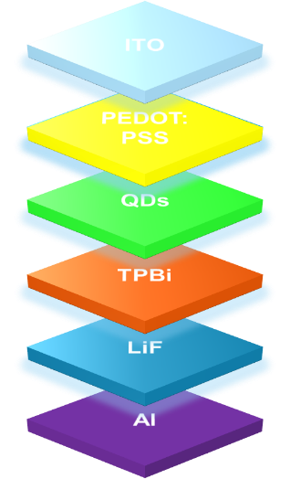
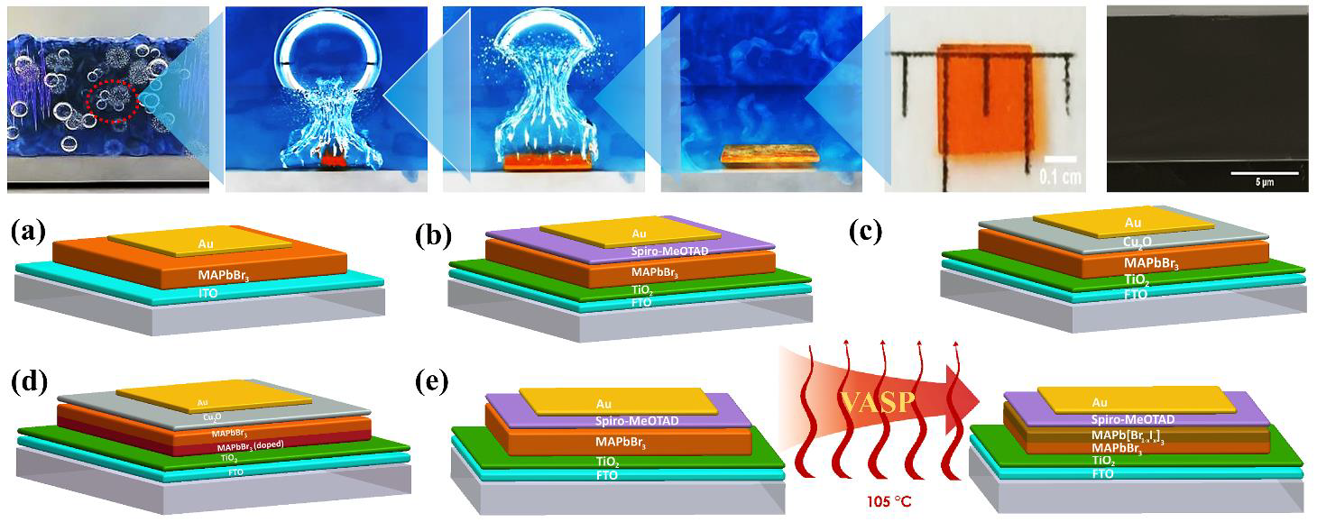
v

Slide 17
Au/Ag
Au/Ag
HTL
Electron injection layer
Perovskite QDs
Perovskite QDs emission layer
ETL
Hole injection layer
ITO/FTO
ITO/FTO
Flexible substrate
Flexible substrate
Figure 2. Flexible solar cell and LED devices using perovskite QDs

Slide 18
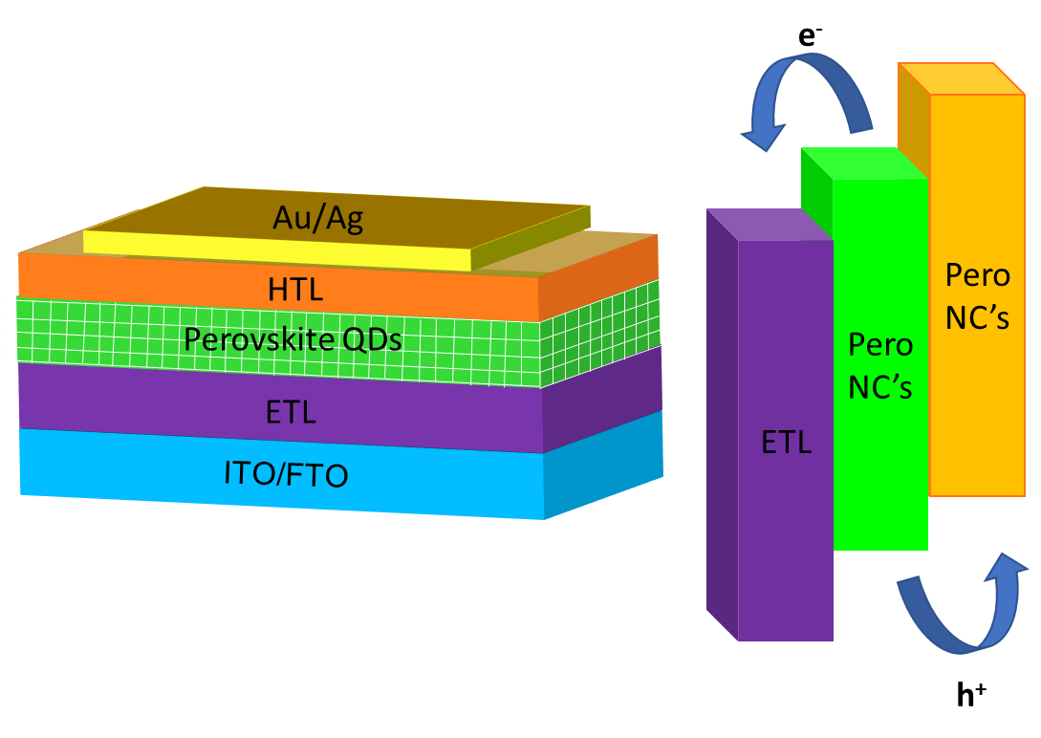
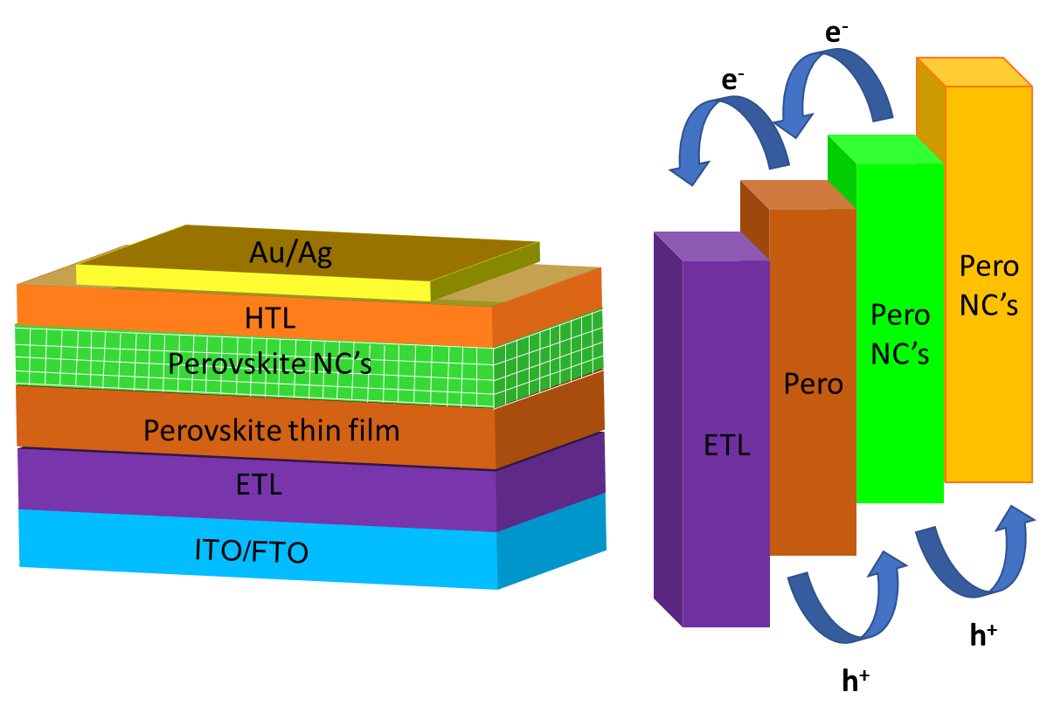
solar device utilizing NCs on top of perovskite thin ﬁlm.

Slide 20
e⁻
Perovskite
TiO₂ /NiO
Pero
Au/Ag
ETL
HTL
Mesoporous scaﬀold
ITO/FTO
Perovskite sensitized in an active scaﬀold

Slide 21
e⁻
X
Perovskite
Al₂O₃/SiO₂/ZrO₂
Pero
Au/Ag
_{ETL}
HTL
Mesoporous scaﬀold
ITO/FTO
Perovskite sensitized in an passive scaﬀold

Slide 22
e⁻
HTL
Pero
ETL
Au/Ag
HTL
Perovskite thin film
ETL
ITO/FTO
h⁺

Slide 23
e⁻
e⁻
HTL
Pero NC’s
Pero
Au/Ag
ETL
HTL
Perovskite NC’s
Perovskite thin film
ETL
ITO/FTO
h⁺
h⁺

Slide 24
e⁻
HTL
Pero NC’s
Au/Ag
ETL
HTL
Perovskite QDs
ETL
ITO/FTO
h⁺

Slide 25
a)
b)
c)

Slide 26
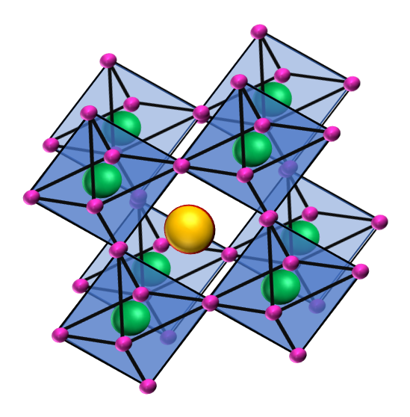
t = ₍ra + rx_{))/}√2(rb+ rx)
Perovskite ABX₃
A=
B=
X=

Slide 28
Au/Ag
Interface Layer
Perovskites
ITO/FTO

Slide 29
ITO/FTO

Slide 30
S
Perovskites
D
Dielectric Layer
Substrate

Slide 31
Au/Ag
Interface Layer
Perovskites
ITO/FTO

